Slide 1
ECOMMERCE
PROGRES & PLANNING 2012

Slide 2
Vision & Mission
Creating E-Commerce for Electronic City
Creating Systems and Strategic
Creating Branding on Internet

Slide 4
OLD WEBSITE
JUNE – AUG 2012

Slide 5
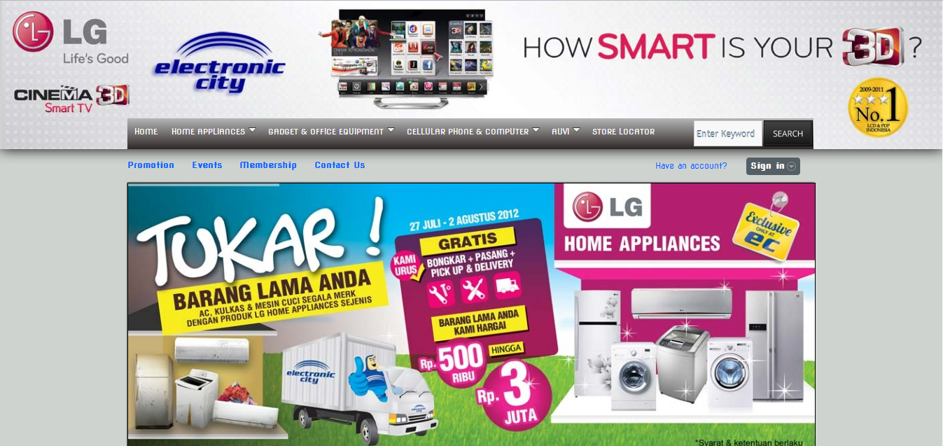
HEADER + BODY 1

Slide 6
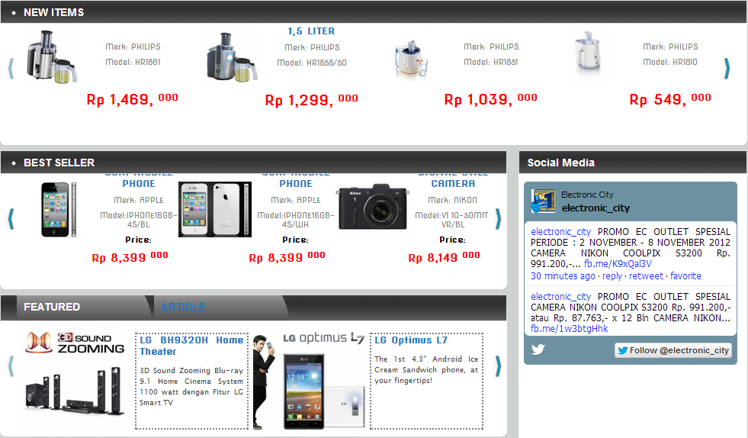
BODY 2 + BOTTOM

Slide 7
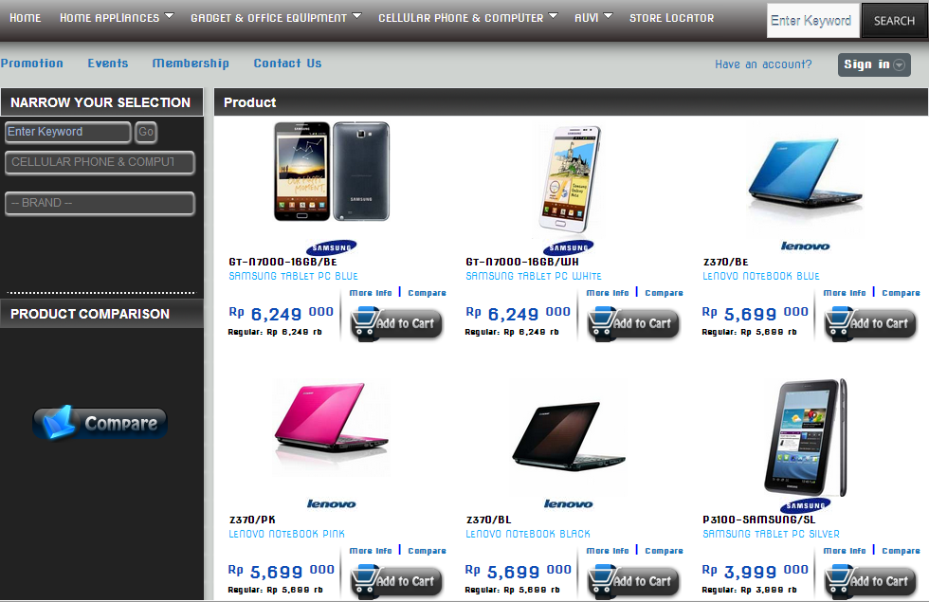
PRODUCT

Slide 8
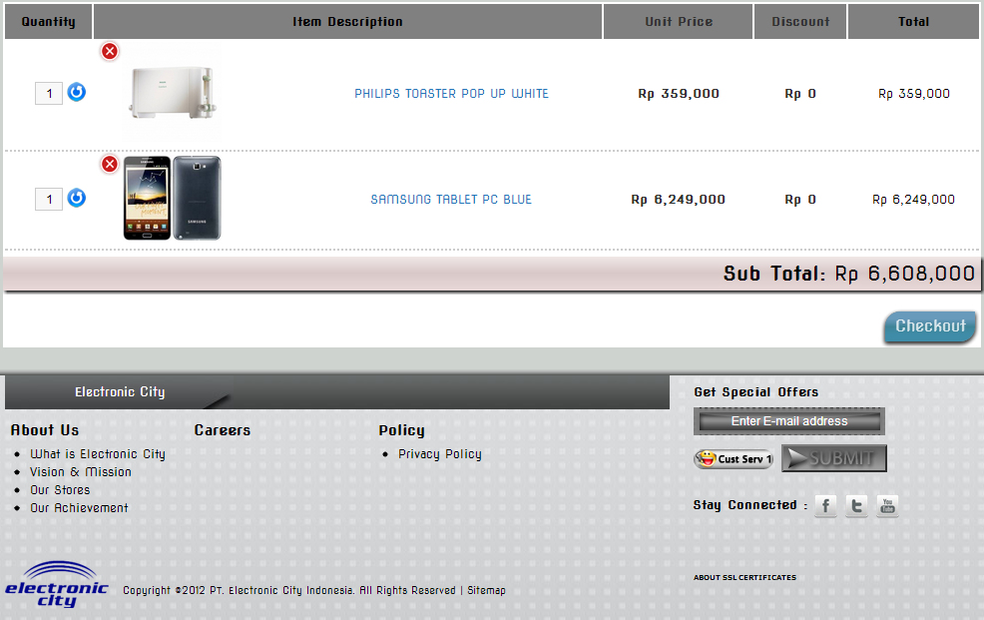
CART

Slide 9
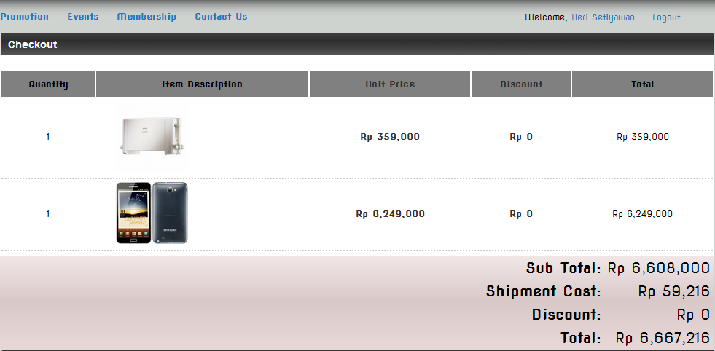
CHECKOUT PROSES 1

Slide 10
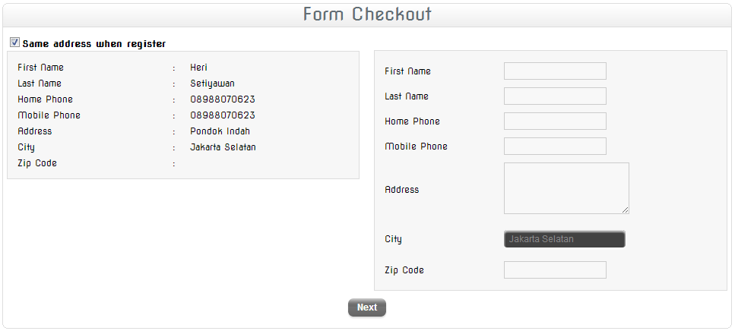
CHECKOUT

Slide 11
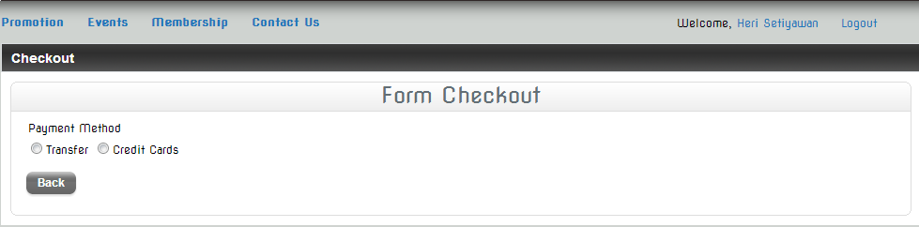
PAYMENT METHODS

Slide 12
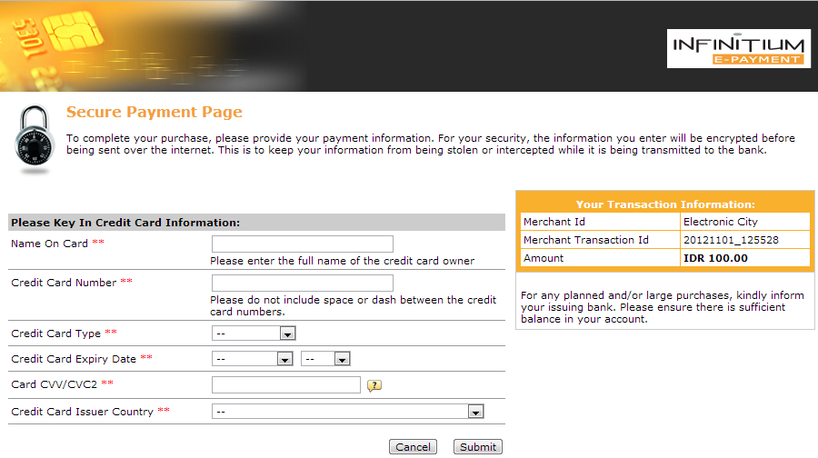
PAYMENT GATEWAY

Slide 13
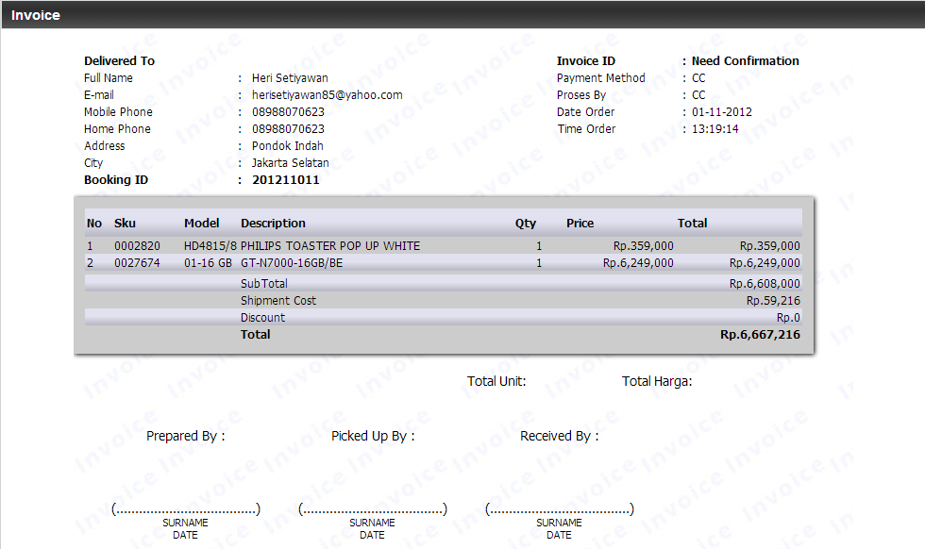
INVOICE

Slide 14
TEMP WEBSITE
MARKETING WEB

Slide 15
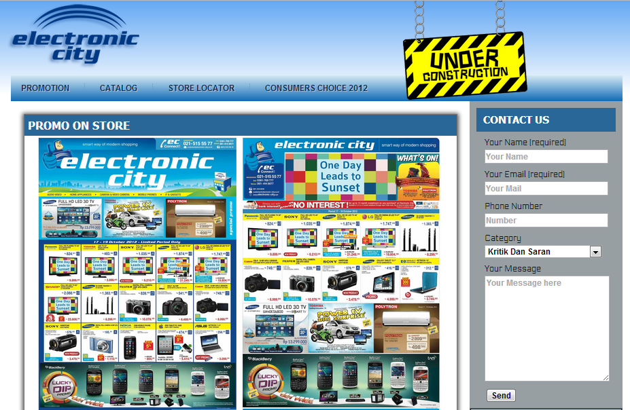
HOMEPAGE

Slide 16
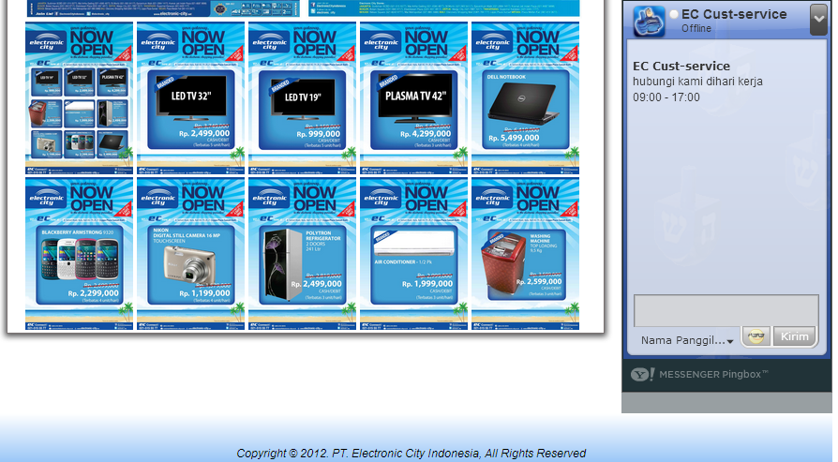
PROMOTION

Slide 17
NEW DEV.
CURRENT

Slide 18
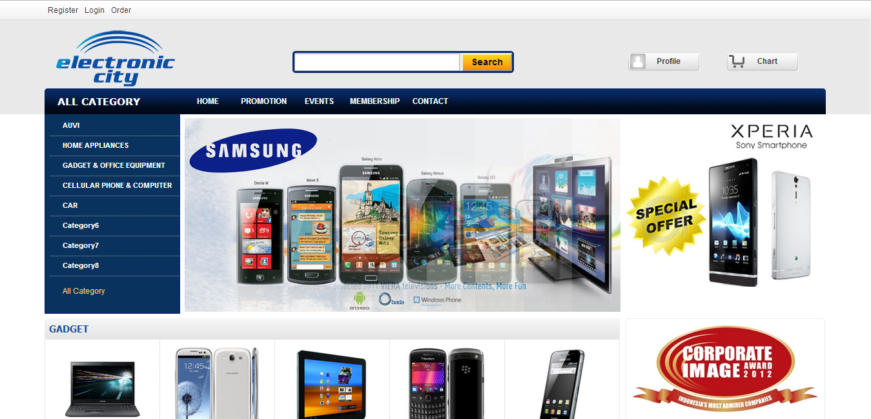
HOMEPAGE

Slide 19
Planning
STEP 1
Creating Online Shop
Adjusting Customers Needs
Co. With Payment Gateway, and Logistics Partners
Branding on Social Media
STEP 2
Creating Review and Blogs for Online Shop
Creating Promotion and Event on Internet (inc. Social Media)
STEP 3
Creating Mobile Commerce on Current Trend
Create Mobile Application for Mobile Marketing

Slide 20

Domain
ELECTRONIC-CITY
ECSHOPPINGSTORE.COM
ELECTRONICCITY.CO.ID
ELECTRONIC-CITY.CO.ID
ELECTRONIC-CITY.NET
ECITY.CO.ID
ELECTRONIC-CITY-INDONESIA.COM
GKT
SERVICE.CO.ID
ESERVICE.CO.ID
GKT.CO.ID
ON PROGRESS
ELECTRONIC-CITY.COM
STILL ONGOING ON BIDDING TO DOMAIN OWNER REQ UP TO $ 5000 OR MORE

Slide 21
E-COMMERCE NEEDS
Product Details
Security Server and TradeMarks
Security of Fraud (Payment Gateway)
Products Systems (Stock, Event, Promotion)

Slide 22
COMPETITOR
eCommerce (Online Shop) Indonesia Top Brand Award 2012
No. | Website | Top Brand Index (TBI)
1 | tokobagus.com | 47.5%
2 | kaskus.co.id | 15.6%
3 | berniaga.com | 5.4%
4 | bhinneka.com | 5.2%
Source: www.topbrand-award.com/top-brand-survey/survey-result/top-brand-result-2012/

Slide 23
COMPETITOR
eCommerce Indonesia by Alexa Rank ID
No. | Website | Alexa Rank ID
1 | tokobagus.com | 18
2 | berniaga.com | 26
3 | bhinneka.com | 53
4 | lazada.co.id | 73
5 | zalora.co.id | 154
6 | blibli.com | 199
7 | hartonoelektronika.com | 1830
Source: www.alexa.com

Slide 24
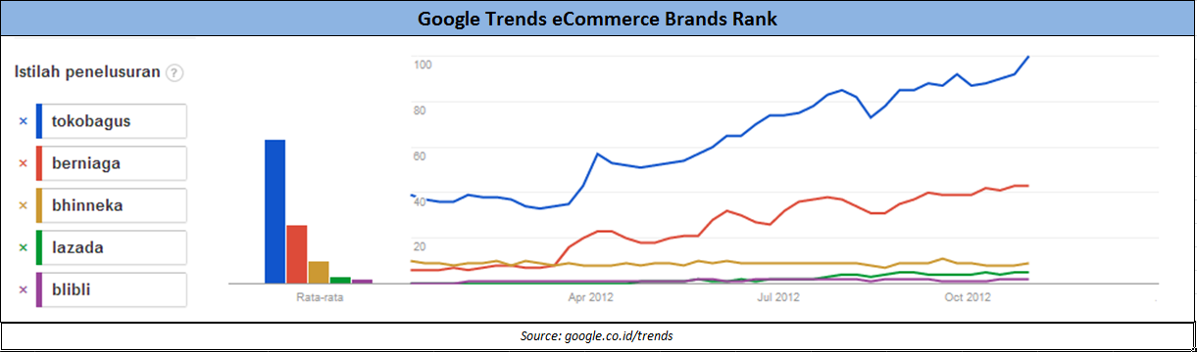
COMPETITOR

Slide 25







SOCIAL MEDIA

Slide 26
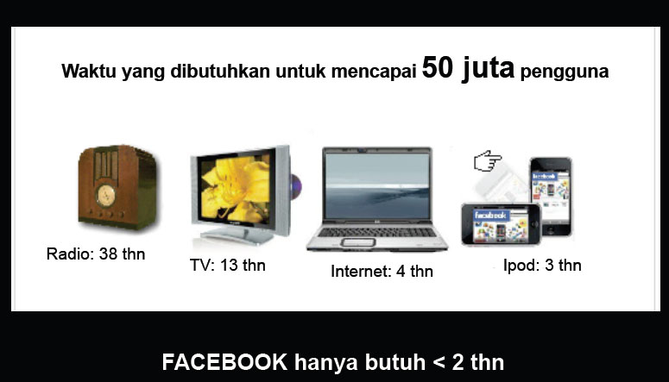
SOCIAL MEDIA

Slide 27
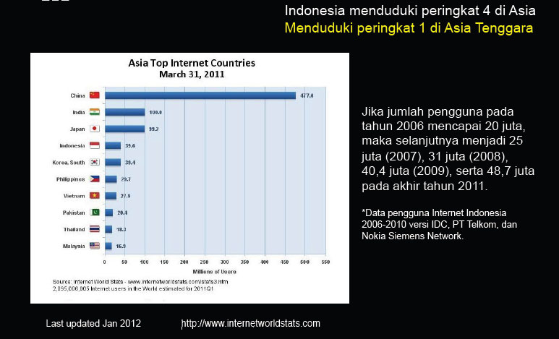
SOCIAL MEDIA

Slide 28
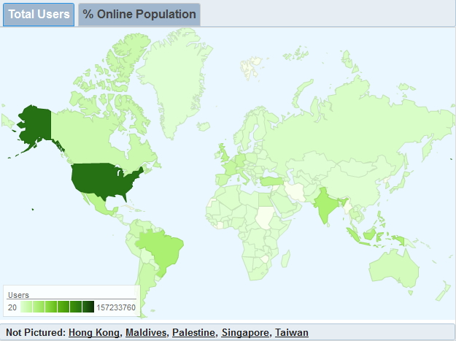
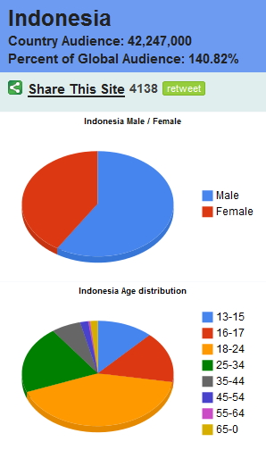
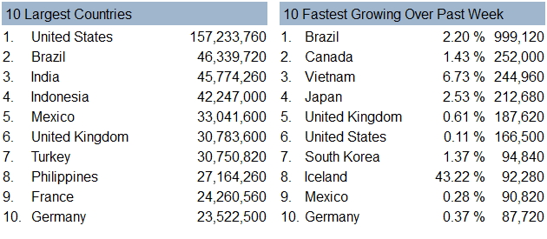
SOCIAL MEDIA

Slide 29
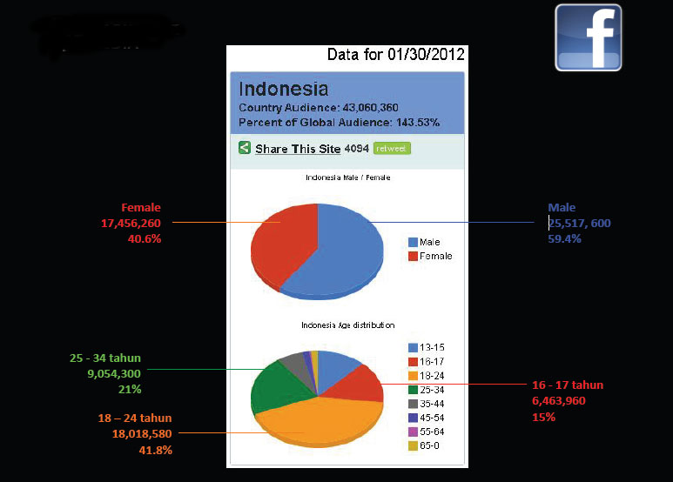
SOCIAL MEDIA

Slide 30
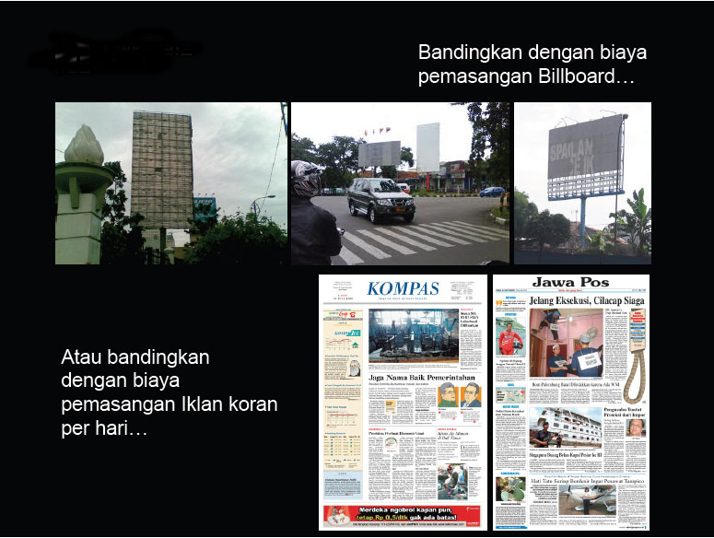
SOCIAL MEDIA

Slide 31
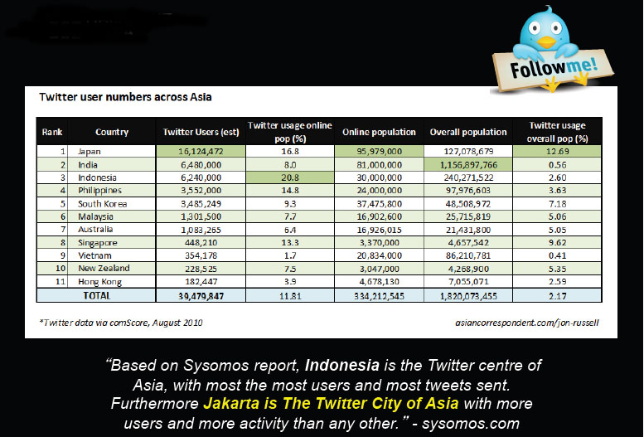
SOCIAL MEDIA

Slide 32
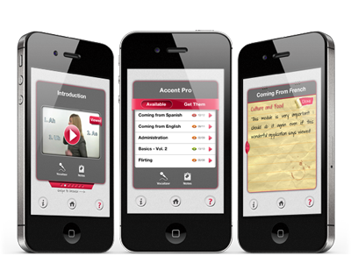
MOBILE COMMERCE
iOS, Android, Blackberry, Windows Mobile

Slide 33
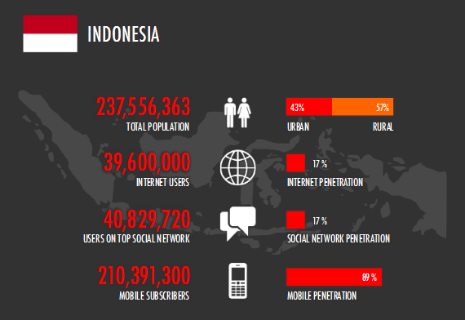
MOBILE APPS

Slide 34
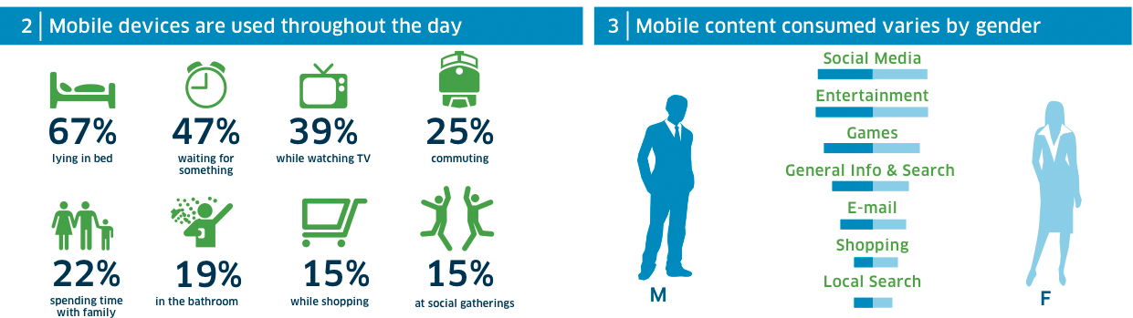
MOBILE APPS

Slide 35
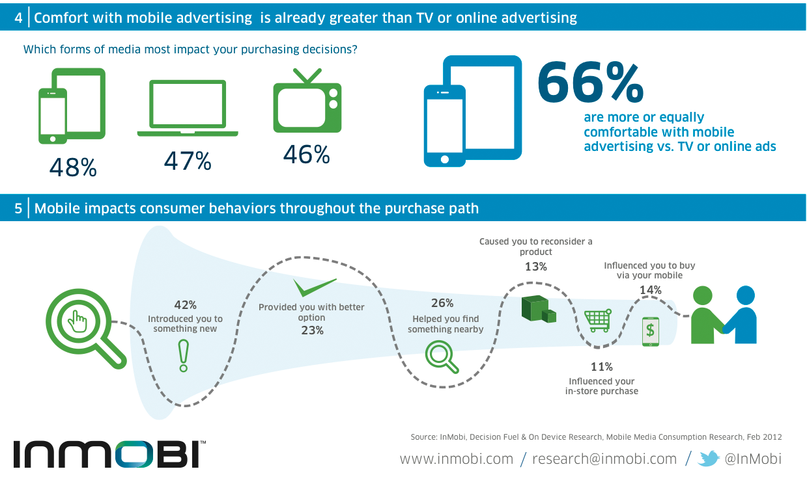
MOBILE APPS

Slide 36
THANK YOU

